Slide 1

Study on Deep-Sea Fish Detection Using Convolutional Neural Networks (CNNs)
Presentation-2
CSC-698 Thesis
Under the Guidance of
Dr. Joe Zhang
By:
Poojitha Priyadarshini Madari
August 26 2025

Slide 2
https://github.com/alzayats/DeepFish
Total Images: 4,505
Total Bounding Boxes: 15,463 – Annotation(Locations Marked)
Training and Validation Split: 80% Train(3604), 20% Valid(901)
Folder Structure:
21 main folders – each representing different fish Environment
Each folder contains train/ and valid/ subfolders
DATASET
Multajam, Rizki, et al. "Real-time detection and classification of fish in underwater environment using YOLOv5: a comparative study of deep learning architectures." Informatyka, Automatyka, Pomiary w Gospodarce i Ochronie Środowiska 14 (2024). – Goldfish,koi fish dataset with Random Samples
Saleh, Alzayat, Marcus Sheaves, and Mostafa Rahimi Azghadi. "Computer vision and deep learning for fish classification in underwater habitats: A survey." Fish and Fisheries 23.4 (2022): 977-999. - small size, moderate Size and Large sized including grey scale fish Dataset.
Al Muksit, Abdullah, et al. "YOLO-Fish: A robust fish detection model to detect fish in realistic underwater environment." Ecological Informatics 72 (2022): 101847. Deepfish dataset, Ozfish Dataset and Mixed Dataset. Yolo Fish-1 & Yolo Fish-2 models

Slide 3
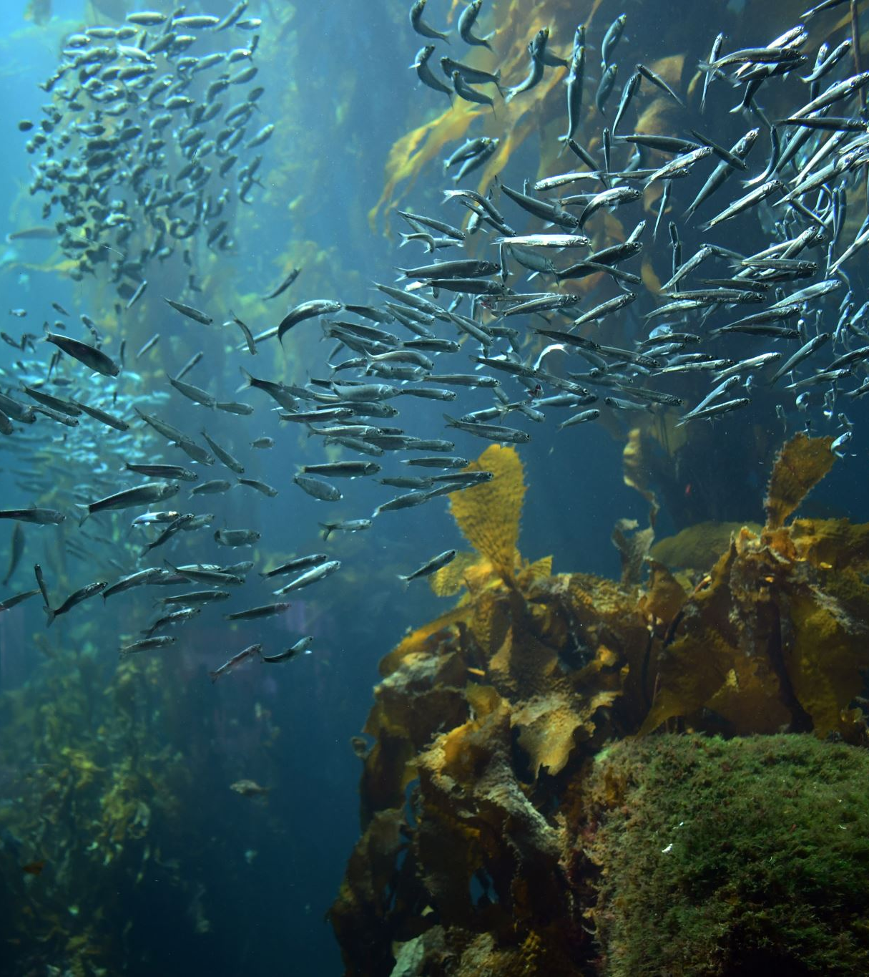
Each numbered folder represents a different underwater environment
Water conditions (clear vs. murky water)
Lighting (bright sunlight vs. deep ocean darkness)
Habitat types (coral reefs, sandy bottoms, seagrass)
Fish behaviors (schooling, solitary, feeding)
Camera angles (side view, top-down, oblique)
Binary classification – fish, no fish

Slide 4
Validation Process (20% of data)
Test the model on images it hasn't seen
Measure accuracy without giving it the answers
Ensure generalization - works on new, unseen data
This diversity helps the model work in any underwater condition, not just perfect laboratory settings.How the Dataset Works in YOLO Training
Training Process (80% of data)
Show the model thousands of fish images
Tell it exactly where each fish is located
Model learns patterns like:
Fish shapes and colors
How fish look in different lighting
Background vs. fish differences
Fish sizes and orientations

Slide 5
Annotation Format Explained
YOLO Format Labels
Each fish location is marked with 5 numbers:
text
0 0.47994791666666664 0.14351851851851852 0.12135416666666667 0.21481481481481482
Breaking it down:0 = Class ID (0 = Fish)
0.4799... = Center X position (relative to image width)
0.1435... = Center Y position (relative to image height)
0.1213... = Width of fish (relative to image width)
0.2148... = Height of fish (relative to image height)
Why Relative Coordinates?
Works with any image size
Scale-invariant - fish can be big or small
Resolution-independent - works on high or low quality images

Slide 6
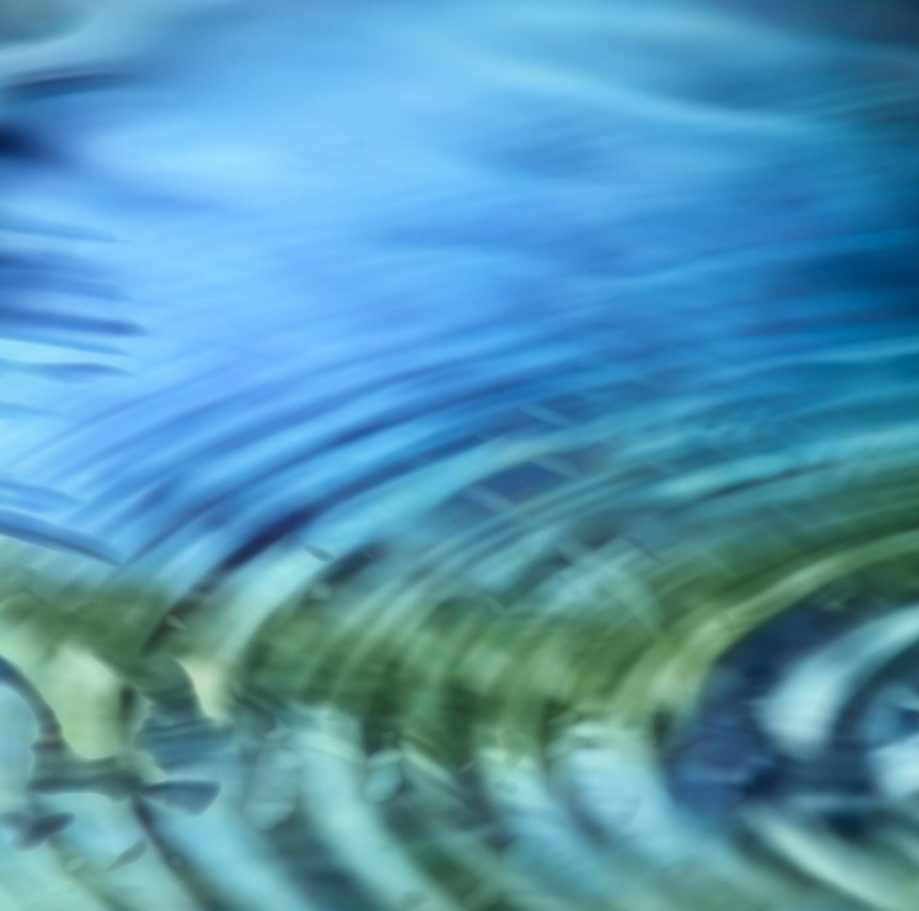
Underwater Challenges
Light absorption: Colors change with depth
Water clarity: Particles and plankton affect visibility
Fish camouflage: Many fish blend with backgrounds
Dynamic environments: Fish move and water flows

Slide 7
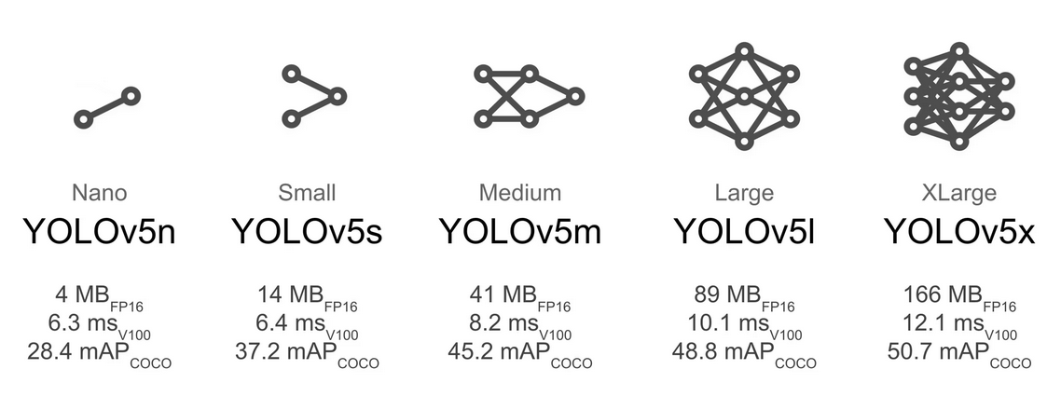

Slide 8

Thank You!!!

